Slide 1
PINN based PMSM Parameter estimation

Slide 2
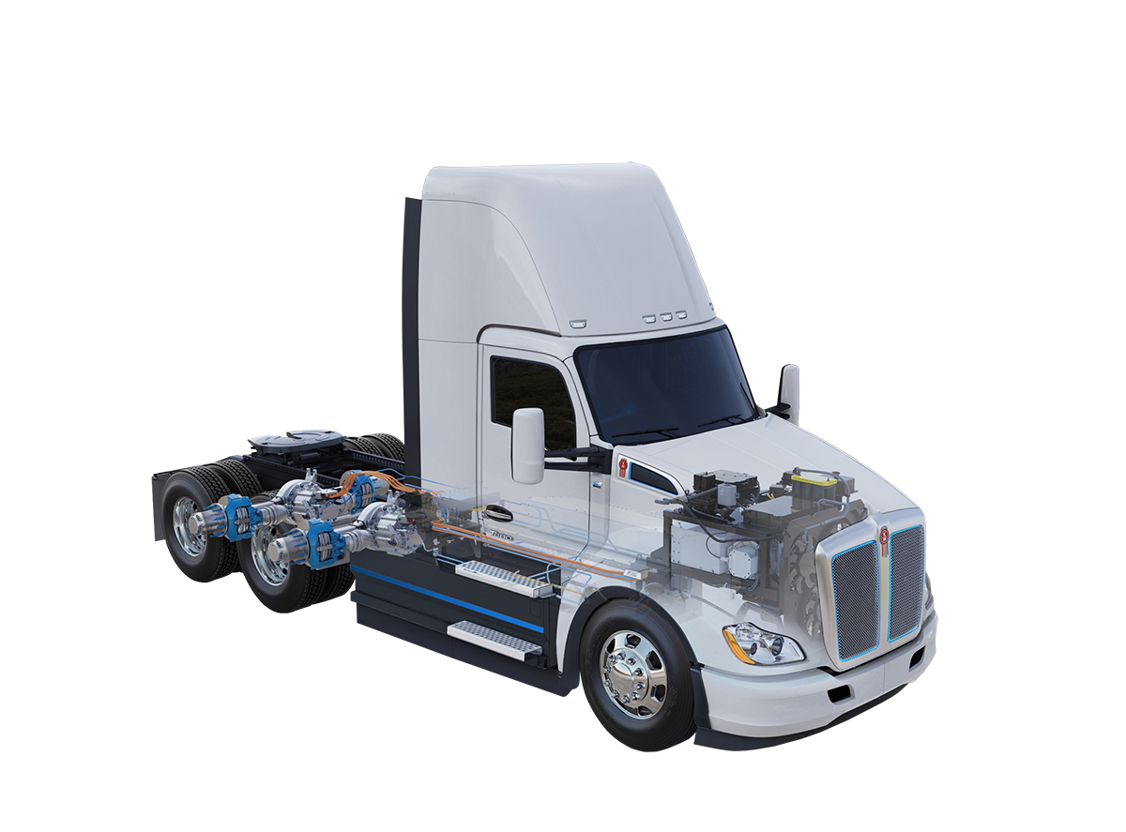
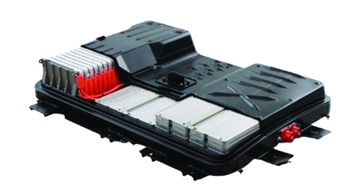
System Overview
Traction
Battery
Traction
Inverter
Traction
Electric
Machine
Heavy-duty
Gear Box
Differential Gear
≈ 98%
Efficient
≈ 95%
Efficient
≈ 95%
Efficient
≈ 70% - 95 %
Efficient
Optimizing the operation of electric machines yields significant efficiency gains.

Slide 3
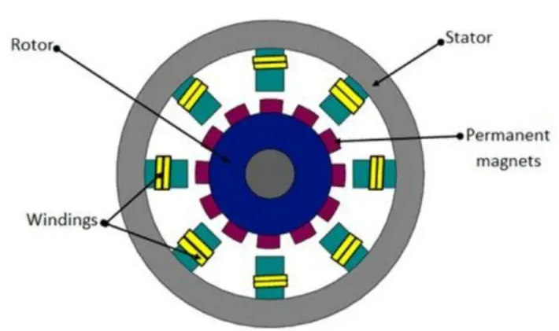
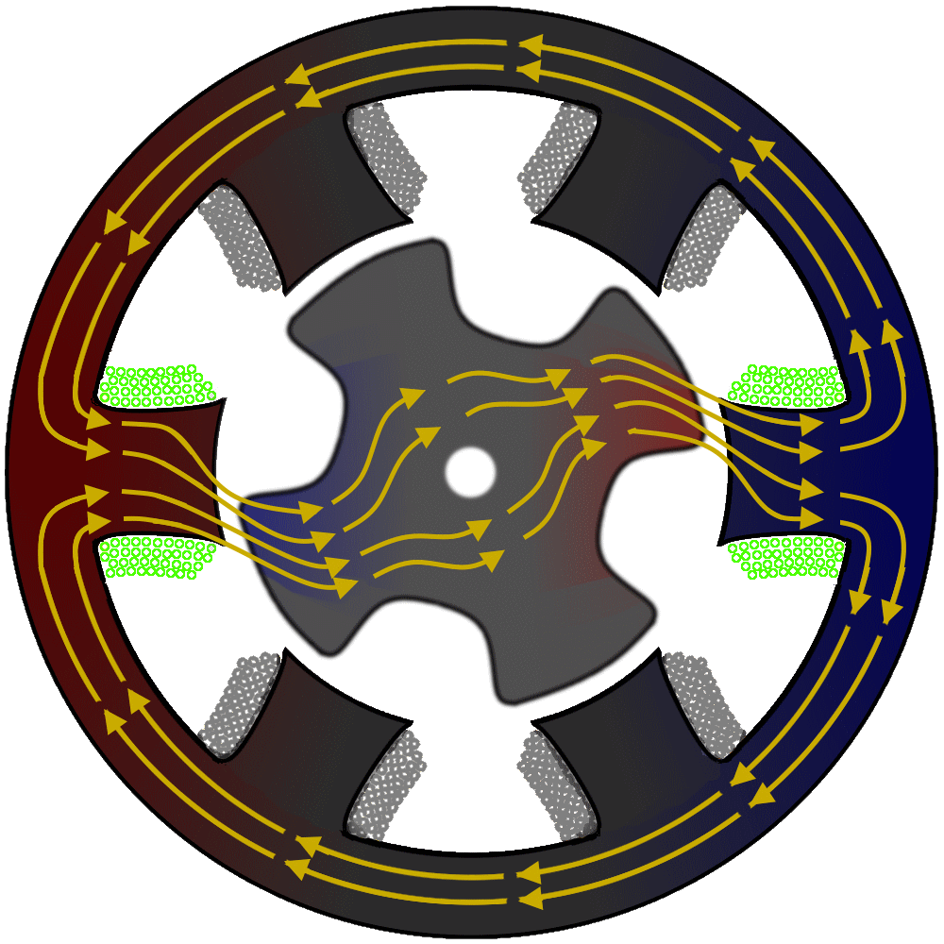
Permanent Magnet Synchronous Machine (PMSM)
Stator winding becomes electromagnet when current passes.
Electromagnet insert force on permanent magnets to rotate it
Drive control is responsible for generating the required current for electromagnets to produce the required torque

Slide 4
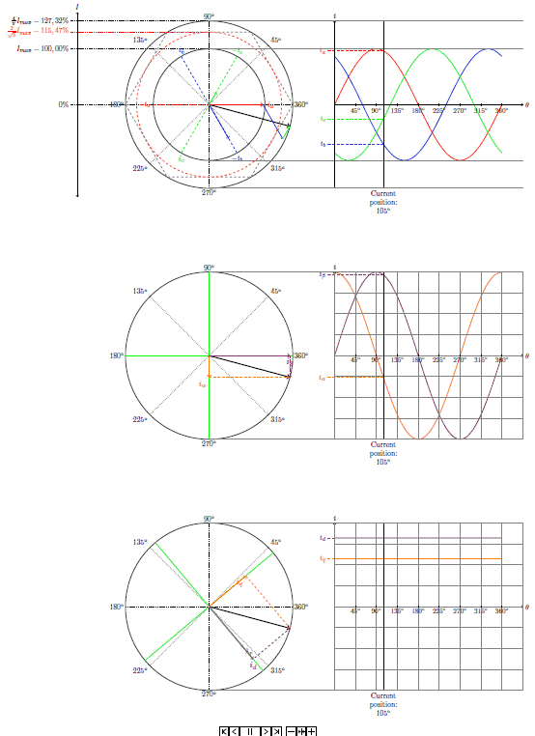
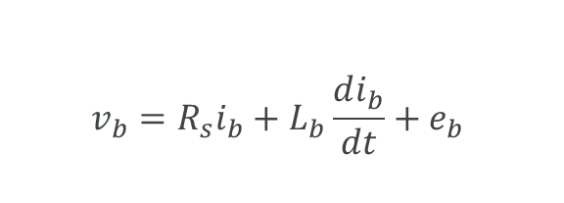
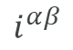
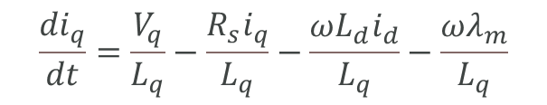
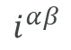
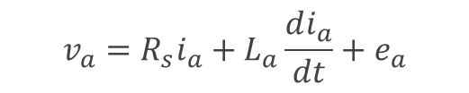
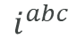
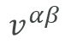
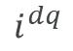
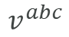
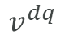
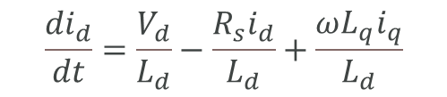

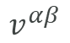
PMSM Modeling
Equivalent DC System
3 Phase AC System
2 Phase Equivalent AC System
$$v^{αβ}$$
Transformation Matrix
$$v^{dq}$$
$$i^{αβ}$$
$$i^{dq}$$
$$\frac{{di}_{d}}{dt}=\frac{V_{d}}{L_{d}}−\frac{R_{s}i_{d}}{L_{d}}+\frac{ωL_{q}i_{q}}{L_{d}}$$
$$v_{a}=R_{s}i_{a}+L_{a}\frac{di_{a}}{dt}+e_{a}$$
$$\frac{{di}_{q}}{dt}=\frac{V_{q}}{L_{q}}−\frac{R_{s}i_{q}}{L_{q}}−\frac{ωL_{d}i_{d}}{L_{q}}−\frac{ωλ_{m}}{L_{q}}$$
$$v_{b}=R_{s}i_{b}+L_{b}\frac{di_{b}}{dt}+e_{b}$$
$$v^{abc}$$
Transformation Matrix
$$v^{αβ}$$
$$i^{abc}$$
$$i^{αβ}$$
$$v_{c}=R_{s}i_{c}+L_{c}\frac{di_{c}}{dt}+e_{c}$$
Clark Transformation
Park Transformation

Slide 5
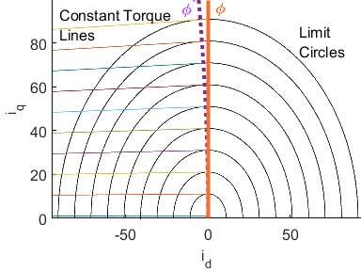
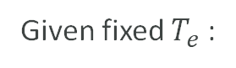
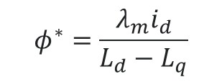
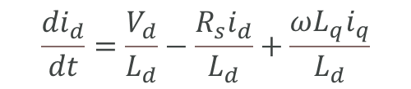
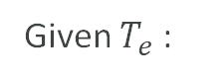
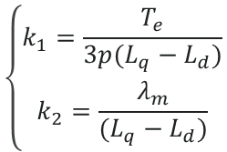

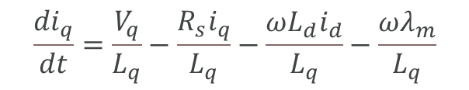
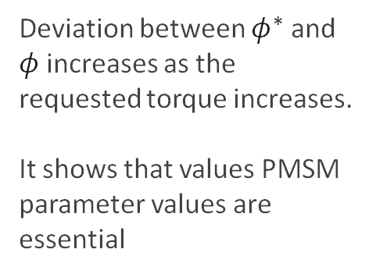
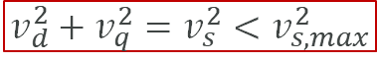
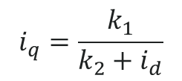
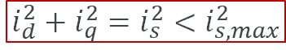

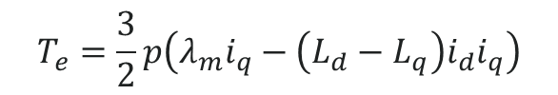

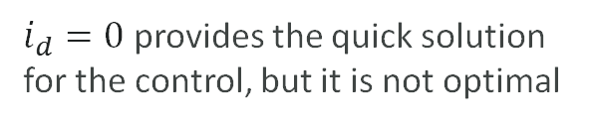
PMSM Control
$φ$Shows $i_{d}=0$ trajectory and $φ^{∗}$ shows MTPA trajectory
Controller (MTPA)
For the EV application, PMSM control should provide torque efficiently
Global Constraint (for All $T_{e}$ values )
Given $T_{e}$:
Dynamics
$$i_{d}^{2}+i_{q}^{2}=i_{s}^{2}<i_{s,max}^{2}$$
Current constraint
$$\frac{{di}_{d}}{dt}=\frac{V_{d}}{L_{d}}−\frac{R_{s}i_{d}}{L_{d}}+\frac{ωL_{q}i_{q}}{L_{d}}$$
$$v_{d}^{2}+v_{q}^{2}=v_{s}^{2}<v_{s,max}^{2}$$
Voltage constraint
$$\frac{{di}_{q}}{dt}=\frac{V_{q}}{L_{q}}−\frac{R_{s}i_{q}}{L_{q}}−\frac{ωL_{d}i_{d}}{L_{q}}−\frac{ωλ_{m}}{L_{q}}$$
Local Constraint (for current $T_{e}$ value )
Deviation between $φ^{∗}$ and $φ$ increases as the requested torque increases. It shows that values PMSM parameter values are essential
Given fixed $T_{e}$:
$$\left\{\begin{aligned}k_{1}=\frac{T_{e}}{3p(L_{q}−L_{d})} \\ k_{2}=\frac{λ_{m}}{(L_{q}−L_{d})}\end{aligned}\right.$$
$$i_{q}=\frac{k_{1}}{k_{2}+i_{d}}$$
$$T_{e}=\frac{3}{2}p\left(λ_{m}i_{q}−\left(L_{d}−L_{q}\right)i_{d}i_{q}\right)$$
Optimal Trajectory
$i_{d}=0$ provides the quick solution for the control, but it is not optimal
$$φ^{∗}=\frac{{λ_{m}i}_{d}}{L_{d}−L_{q}}$$

Slide 6
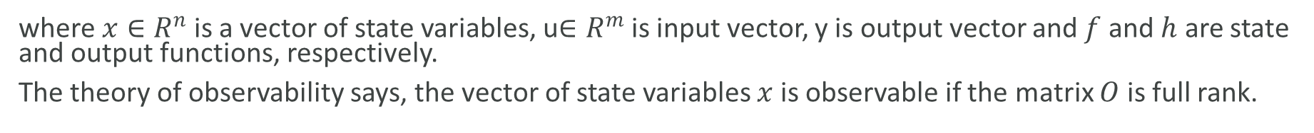

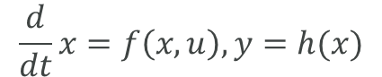
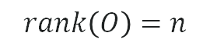
Parameter Observability
For the given dynamic system
$$\frac{d}{dt}x=f\left(x,u\right), y=h(x)$$
where $x∈R^{n}$is a vector of state variables, u$∈R^{m}$is input vector, y is output vector and $f$ and $h$ are state and output functions, respectively.
The theory of observability says, the vector of state variables $x$ is observable if the matrix $O$ is full rank.
$$rank\left(O\right)=n$$
Where
$$O=\frac{∂}{∂x}L$$
$$L=[ℒ_{f}^{0}h,ℒ_{f}^{1}h,ℒ_{f}^{2}h,ℒ_{f}^{3}h,ℒ_{f}^{4}h,ℒ_{f}^{5}h,…ℒ_{f}^{n−1}h]$$
$ℒ_{f}^{k}h$refers to the kth order Lie derivative of output function $h$ .

Slide 7
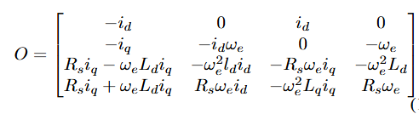
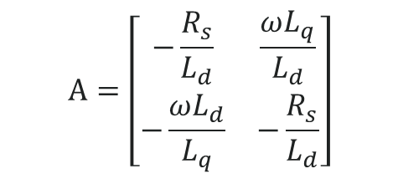
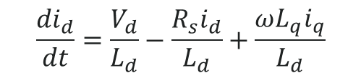
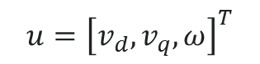
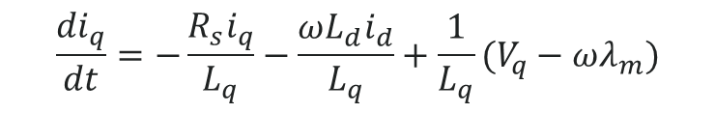
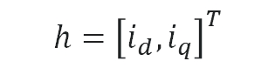
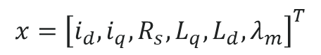
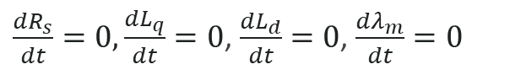
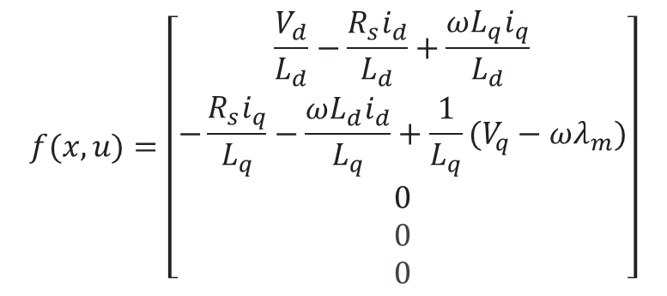
Parameter Observability
Observability Matrix
System Dynamics
$$\frac{{di}_{d}}{dt}=\frac{V_{d}}{L_{d}}−\frac{R_{s}i_{d}}{L_{d}}+\frac{ωL_{q}i_{q}}{L_{d}}$$
$$\frac{{di}_{q}}{dt}=−\frac{R_{s}i_{q}}{L_{q}}−\frac{ωL_{d}i_{d}}{L_{q}}+\frac{1}{L_{q}}(V_{q}−ωλ_{m})$$
$\frac{dR_{s}}{dt}=0,\frac{dL_{q}}{dt}=0$, $\frac{dL_{d}}{dt}=0$, $\frac{dλ_{m}}{dt}=0$
State Space Function
it can be found that O is not full-rank because the second column and the fourth are linearly dependent. it shows that in the steady state; the parameters are not fully observable on the account of rank deficiency.
$$x={\left[i_{d},i_{q},R_{s},L_{q},L_{d},λ_{m}\right]}^{T}$$
$$f(x,u)=\left[\begin{matrix}\frac{V_{d}}{L_{d}}−\frac{R_{s}i_{d}}{L_{d}}+\frac{ωL_{q}i_{q}}{L_{d}} \\ −\frac{R_{s}i_{q}}{L_{q}}−\frac{ωL_{d}i_{d}}{L_{q}}+\frac{1}{L_{q}}(V_{q}−ωλ_{m}) \\ \begin{aligned}0 \\ 0 \\ 0\end{aligned}\end{matrix}\right]$$
$$h={\left[i_{d},i_{q}\right]}^{T}$$
$$u={\left[v_{d},v_{q},ω\right]}^{T}$$
$$A=\left[\begin{matrix}−\frac{R_{s}}{L_{d}} & \frac{ωL_{q}}{L_{d}} \\ −\frac{ωL_{d}}{L_{q}} & −\frac{R_{s}}{L_{d}}\end{matrix}\right]$$
Learning the EM dynamics is way forward to estimate parameters

Slide 8
Literature Survey
Technique | Description | Parameters Estimated | Drawbacks
Offline Testing (Standstill Tests) | Uses resistance measurement, back-EMF test, and locked-rotor test | Rs, Ld, Lq, λm | Time-consuming, needs standstill, not suitable for online estimation
Recursive Least Squares (RLS) | Real-time estimation using input-output data | Rs, Ld, Lq | May diverge with noise or parameter drift, not physics-informed
Impedance Spectroscopy | Frequency-swept tests to obtain impedance vs. frequency | Ld, Lq, Rs | Requires expensive equipment, offline only
High-Frequency Signal Injection | Injects HF voltage and analyzes current response | Ld, Lq | Affects normal operation, not always accurate in non salient machines
Fuzzy Logic / Neural Networks | Uses AI-based models trained on data | Rs, Ld, Lq, λm | Needs large training data, poor generalization, lacks physical interpretability
Finite Element Analysis (FEA) | Simulates electromagnetic behavior of motor | Ld, Lq, λm | Computationally expensive, not suitable for online use

Slide 9
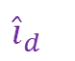
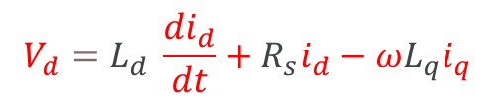
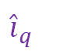
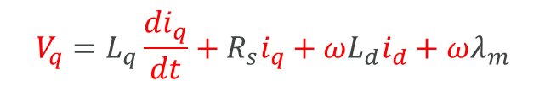
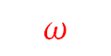


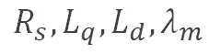
Proposed Method
Physics based dynamics
$${V_{d}=L}_{d} \frac{{di}_{d}}{dt}+R_{s}i_{d}−ωL_{q}i_{q}$$
$$v_{d}$$
Neural Network
$${\hat{i}}_{q}$$
$$V_{q}=L_{q}\frac{{di}_{q}}{dt}+R_{s}i_{q}+ωL_{d}i_{d}+ωλ_{m}$$
$$v_{q}$$
$$ω$$
$${\hat{i}}_{d}$$
Weight Matrix
Known Variables
$$R_{s},L_{q},L_{d},λ_{m}$$
Unknown Variables
Estimated Variables
Physics informed neural network helps to learn the system dynamics efficiently.

Slide 10
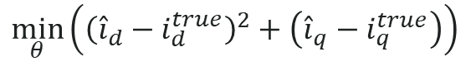
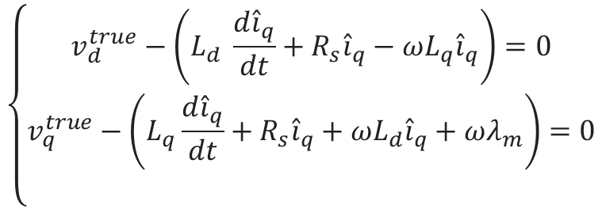
Problem Formulation
$$\min_{θ}\left({\left({\hat{i}}_{d}−i_{d}^{true}\right)}^{2}+\left({\hat{i}}_{q}−i_{q}^{true}\right)\right)$$
True values are obtained from the data
The optimal control problem formulation helps to formulate the loss function
Subject to
$$\left\{\begin{matrix}v_{d}^{true}−\left(L_{d} \frac{d{\hat{i}}_{q}}{dt}+R_{s}{\hat{i}}_{q}−ωL_{q}{\hat{i}}_{q}\right)=0 \\ v_{q}^{true}−\left(L_{q}\frac{d{\hat{i}}_{q}}{dt}+R_{s}{\hat{i}}_{q}+ωL_{d}{\hat{i}}_{q}+ωλ_{m}\right)=0 \\ \end{matrix}\right.$$

Slide 11
PINN for parameter estimator
PMSM parameters are initialized and learned along with neural network weights and biases
This framework can estimate the parameters of rank rank-deficient system

Slide 12

PINN based Parameter Estimator for PMSM
MSE enforce to learn the dynamics from given data
Physics based loss makes sure that learnt NN should represents actual dynamics

Slide 13













PINN Training
Data Logging
$$i_{d}^{true}$$
$$i_{q}^{true}$$
$$v_{q}$$
$$v_{d}$$
US06 Drive Cycle
$$ω$$
Powertrain Simulator
$${\hat{i}}_{d}$$
$${\hat{i}}_{q}$$
$$R_{s}$$
$L_{q}$
$L_{d}$

Slide 14





Results: Case 1 $\left(L_{d}=L_{q}\right)SPMSM$
In surface mount PMSM, $L_{d}=L_{q}$
Given: $λ_{m}=0.192 wb$
Parameter | Actual Value
$$R_{s} [Ω ]$$ | 0.05
$$L_{d} [H]$$ | 0.0021
$$L_{q} [H]$$ | 0.0021
Estimated Value | Accuracy [%]
0.0496 | 99.2
0.0021 | 100
0.0021 | 100

Slide 15





Results: Case 2 $\left(L_{d}<L_{q}\right)IPMSM$
In Interior PMSM, $L_{d}<L_{q}$
Given: $λ_{m}=0.192 wb$
Parameter | Actual Value
$$R_{s} [Ω ]$$ | 0.05
$$L_{d} [H]$$ | 0.0016
$$L_{q} [H]$$ | 0.0021
Estimated Value | Accuracy [%]
0.0495 | 99.2
0.0016 | 100
0.0021 | 100

Slide 16



Simulation Results
The parameter with high correlation input to output, converges faster when $λ$ increases
The PINN framework PMSM estimates the parameters correctly.

Slide 17

Hardware Setup
Power Supply
3kW PMSM parameters are estimated
Data was recorded under different conditions
Only resistance and flux linkage is known
Inverter
Motor Under Test
Speedgoat
Simulink
Load Motor

Slide 18
Thank you
Contact:
Ahmad Hussain Safder (safder.1@osu.edu)
Athar Hanif (hanif.6@osu.edu)
Qadeer Ahmed (ahmed.356@osu.edu)

